Slide 1

CONSUMER SENTIMENT
- TEAM 4

Slide 2
Without data, you’re just another person with an opinion
W. Edwards

Slide 3
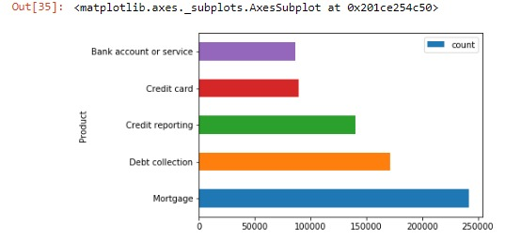
TOP 5 PRODUCT ISSUES

Slide 4
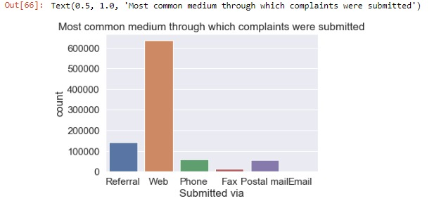
AVENUES USED

Slide 5
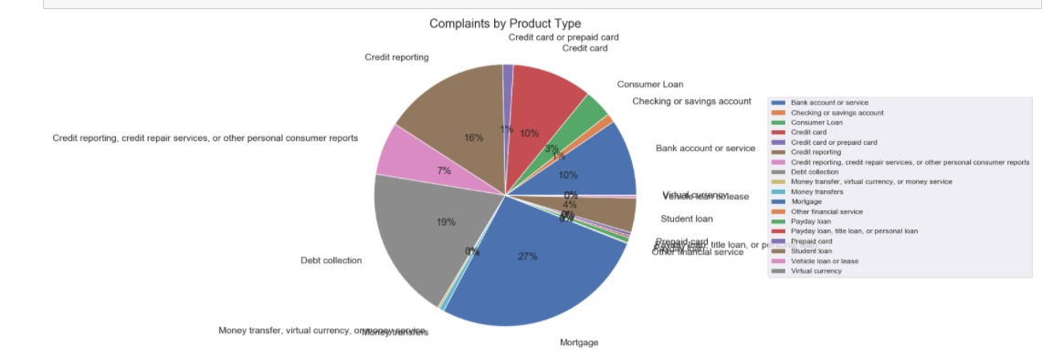
COMPLAINTS BY PRODUCT TYPE

Slide 6
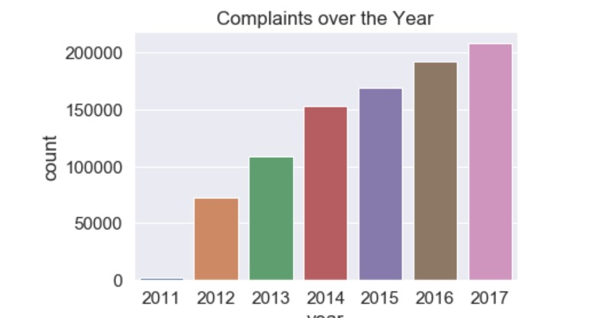
GROWING COMPLAINTS

Slide 7
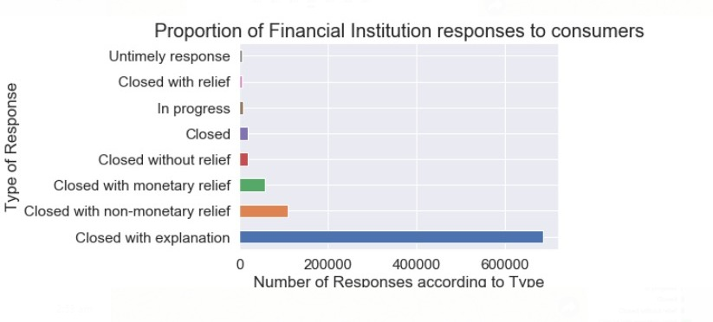
GOOD NEWS!

Slide 8
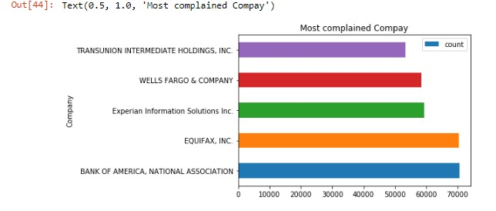
INSTITUTIONS UNDER FIRE

Slide 9
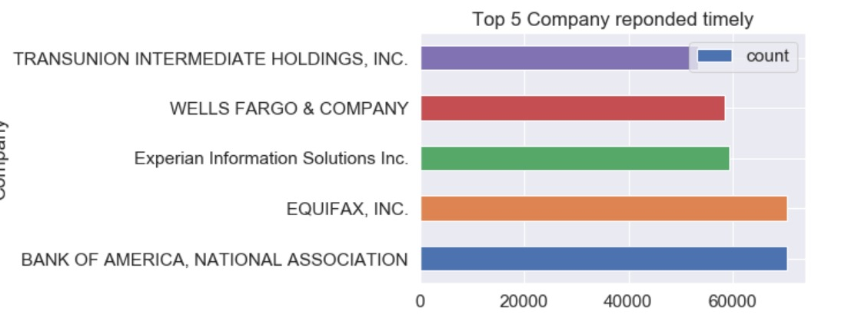
INSTITUTIONS PUTTING OUT THE FIRE

Slide 10

INSIGHTS?

Slide 11
SUMMARY
MORTGAGE AND DEBT COLLECTION ARE THE PRIMARY FOCUS AREAS
BoA & EQUIFAX ARE FRONTRUNEERS IN RESPONDING ON TIME TO THE CUSTOMERS’ SATISFACTION
MOST CUSTOMERS SEEM TECH-SAVVY PREFERRING WEB AND MAIL OVER PHONE CALLS EVEN AS COMPLAINTS WERE RISING YOY
MOST ISSUES WERE CLOSED WITH SUFFICIENT EXPLANATION

Slide 12

DATA TEAM: ANEETHA, PRIYA, VAIKUNTH, ZIA

